Slide 1

Department of Computer Science and Engineering
Power BI and RapidMiner
(5th Semester Skill Enhancement Course)
Global Covid-19 Analysis Power BI Dashboard
Team No : 42
1
Presented By:
Shailesh B S (ENG22CS0159 )
Siddappa L H (ENG22CS0168)
Sathvik G R (ENG22CS0154)
Shreyas C M (ENG22CS0166)
Notes:
Title of the project
CSE Dept., SET-Jain University
1

Slide 2
Abstract
This project analyzes global COVID-19 data to extract actionable insights using Power BI.
The project focuses on data visualization, trend analysis, and supporting informed decision-making.

Slide 3
Problem Statement
The global impact of COVID-19 demands comprehensive data analysis to understand patterns, trends, and mitigation strategies.
This project addresses the need for accessible dashboards for policymakers and researchers.

Slide 4
Objectives
1. Visualize COVID-19 data in an intuitive manner.
2. Identify key trends, patterns, and correlations.
3. Support informed decision-making through actionable insights.

Slide 5
Social/Environmental Impact
This project raises awareness about the pandemic's impact, supports data-driven decisions in healthcare and public policy, and encourages better resource allocation during crises.

Slide 6
Dataset Description
Data Source: WHO, CDC, or other global health repositories.
Key Features: Country/Region, Date, Total Cases, Deaths, Recoveries, Vaccination Data, Population Metrics.
Period Covered: 2020-2022.

Slide 7
Data Preprocessing
Steps include data cleaning, transformation, and integration.
Tools Used: Microsoft Power BI.

Slide 8
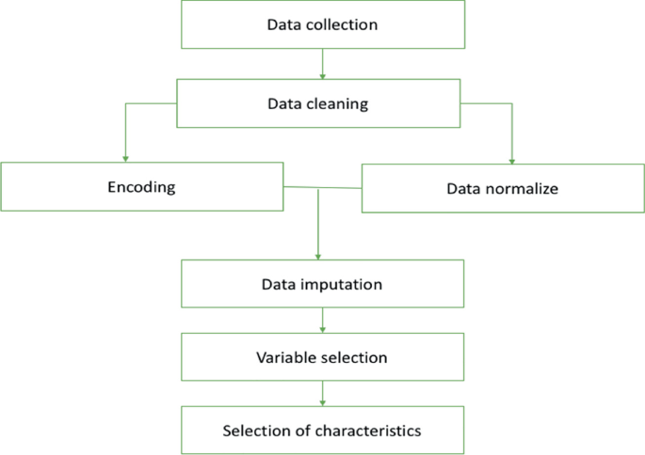

Slide 9
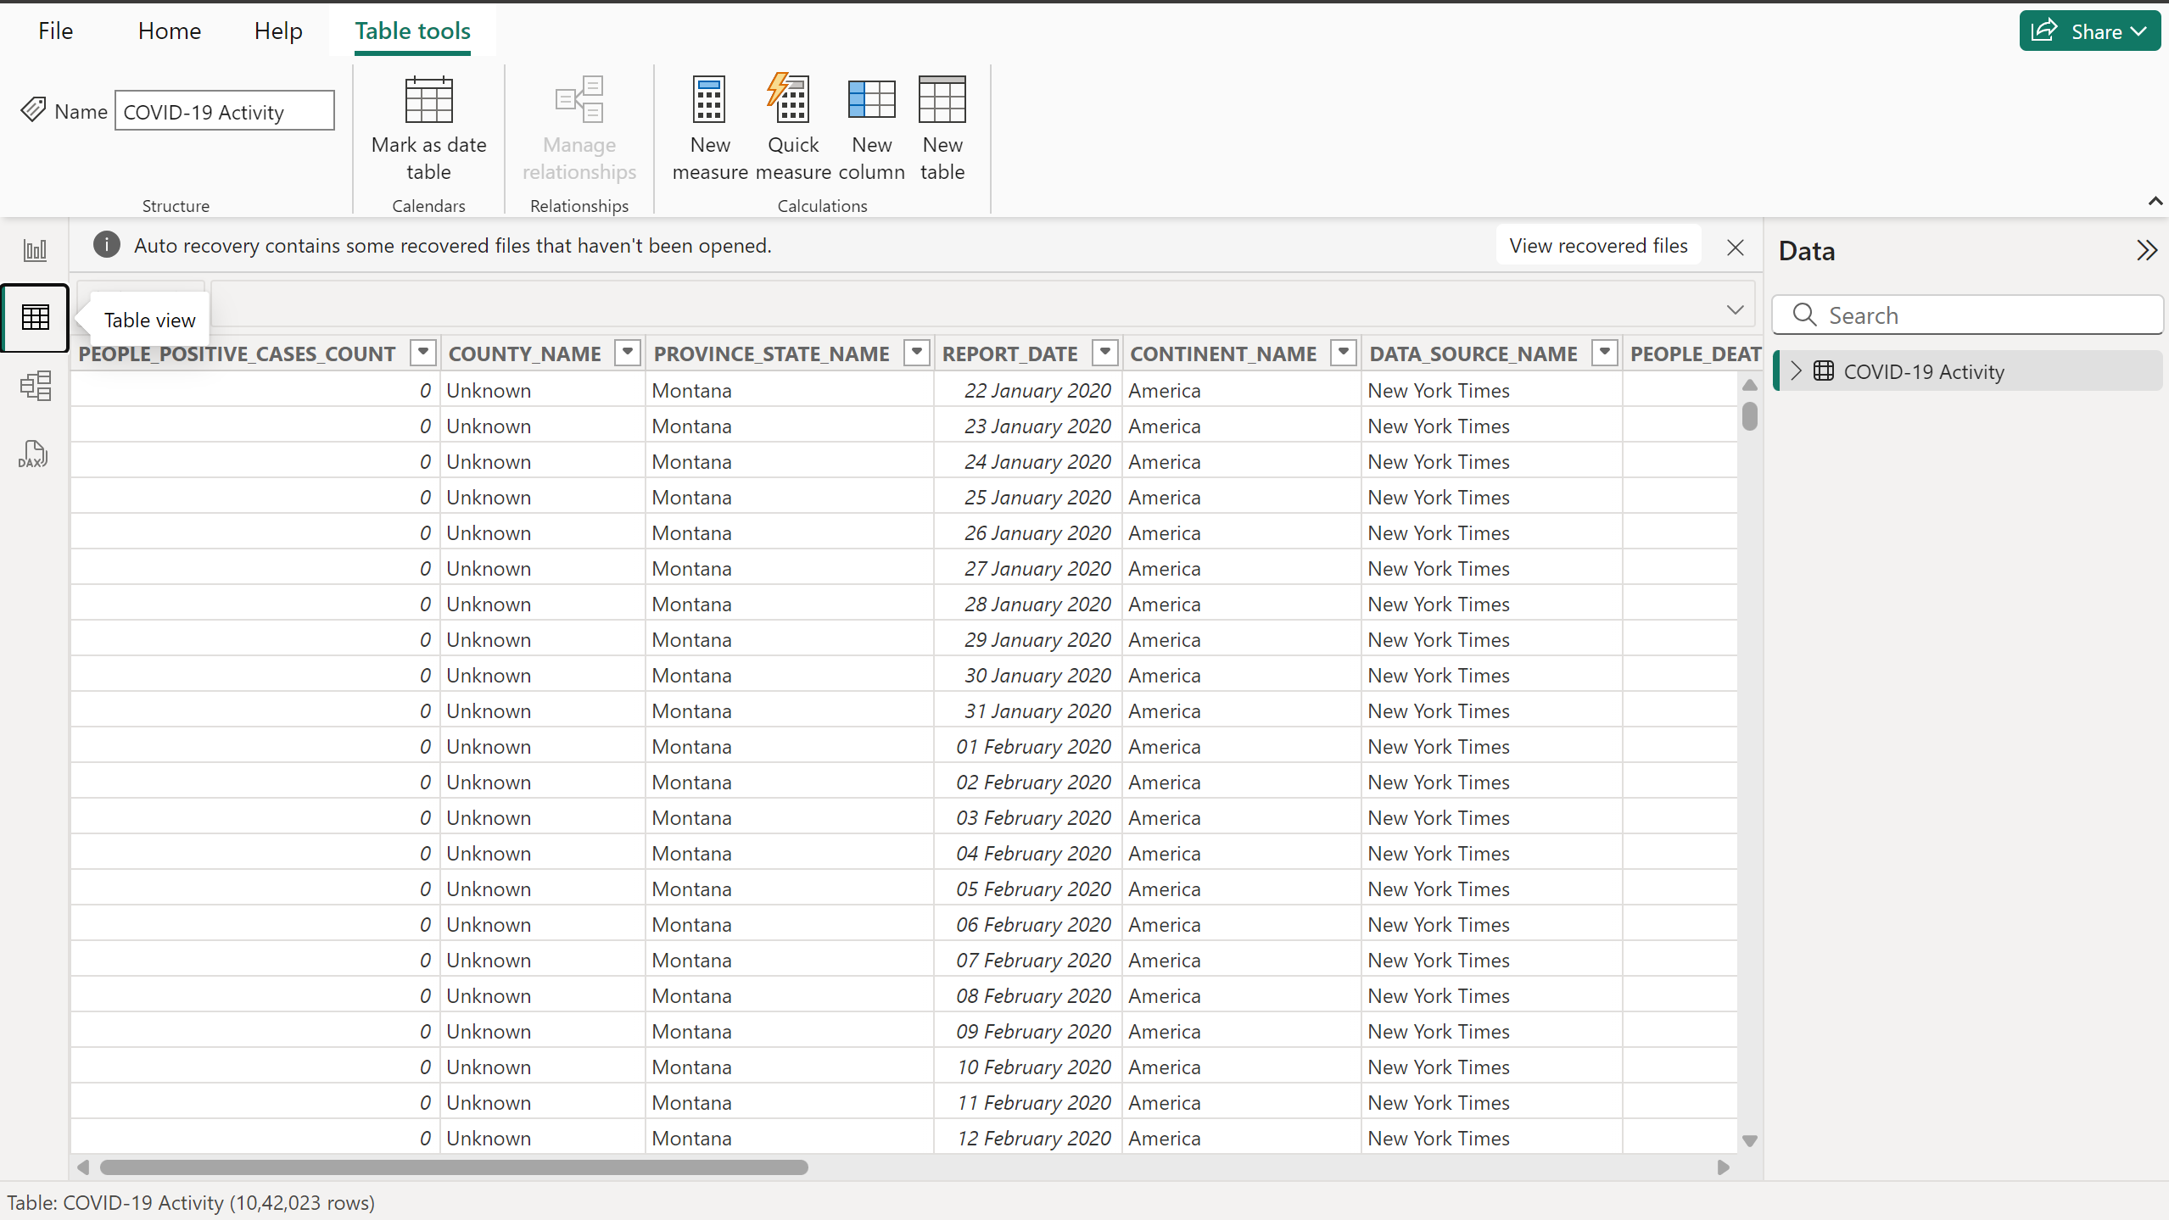
Covid-19 Data

Slide 10
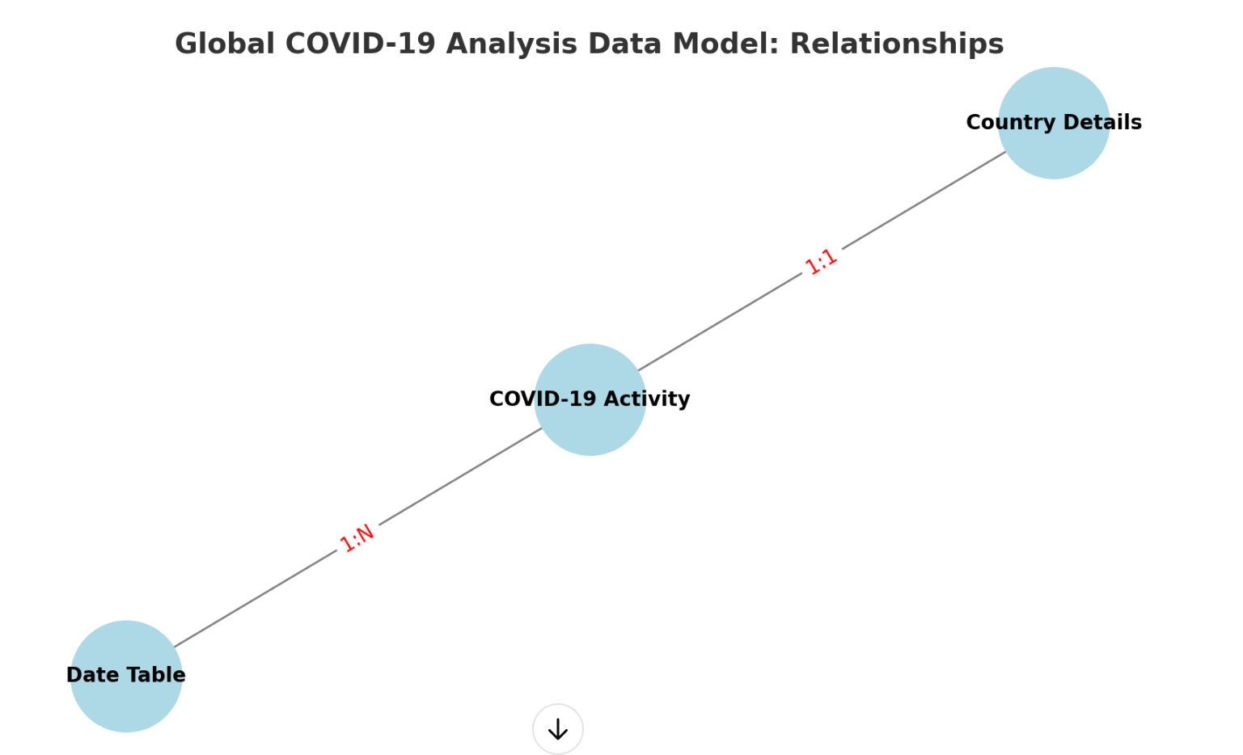
Data Modeling

Slide 11
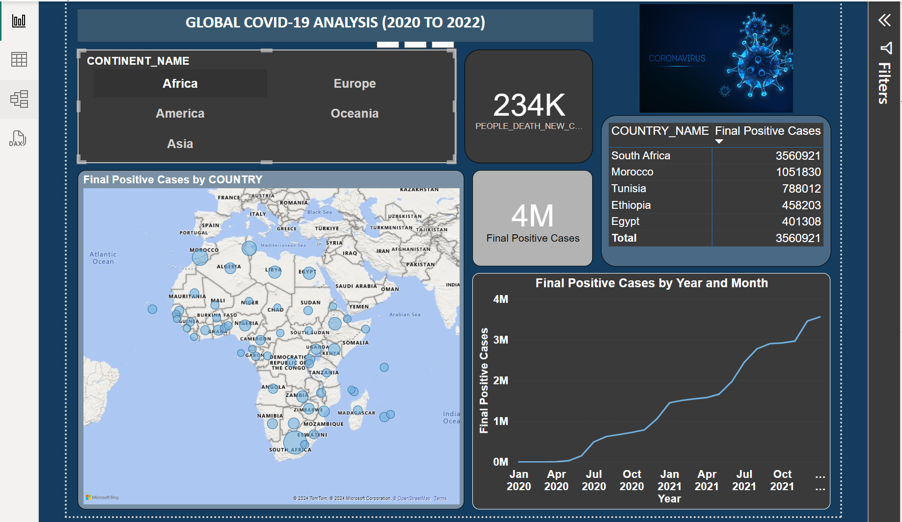
Visualizations

Slide 12
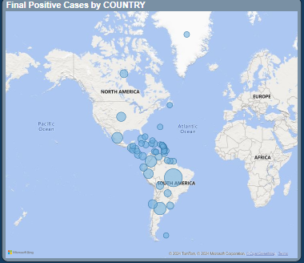
Global Case Distribution(Map View)

Slide 13
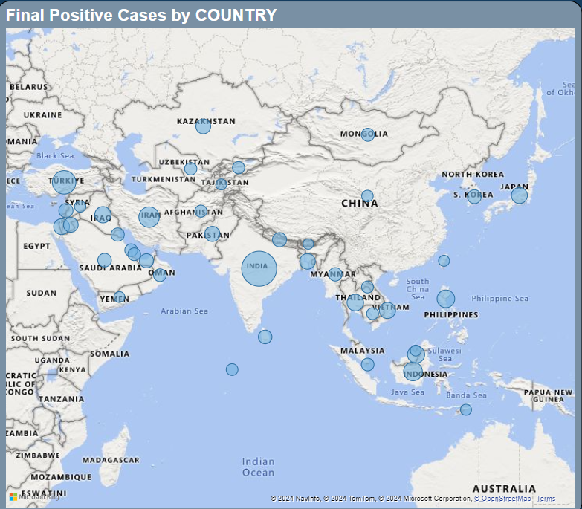

Slide 14
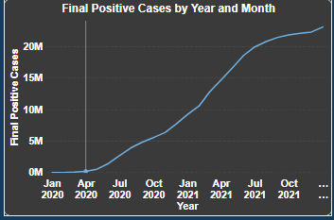
Trend Analysis over Time(Line Analysis)
Trend Analysis over Time(Line Analysis)

Slide 15
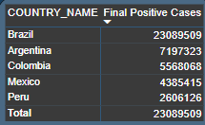
Country wise Comparison

Slide 16
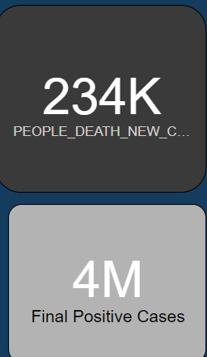
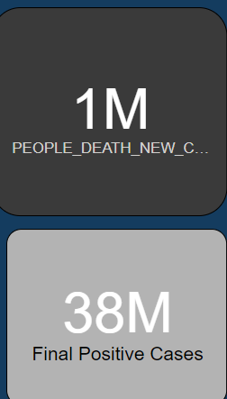
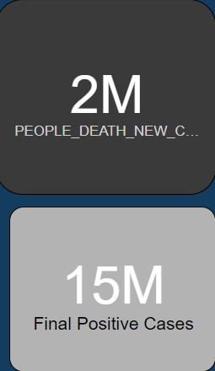
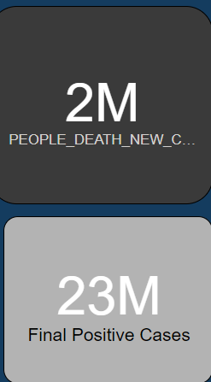
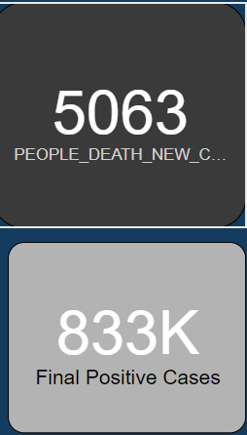
Total Positive Cases and Death Toll
Africa
Asia
Europe
America
Oceania

Slide 17
Insights
Key observations include:
1. Regional differences in infection rates.
2. Correlation between vaccination rates and decline in cases.
3. Predictive trends for future waves or recovery timelines.

Slide 18
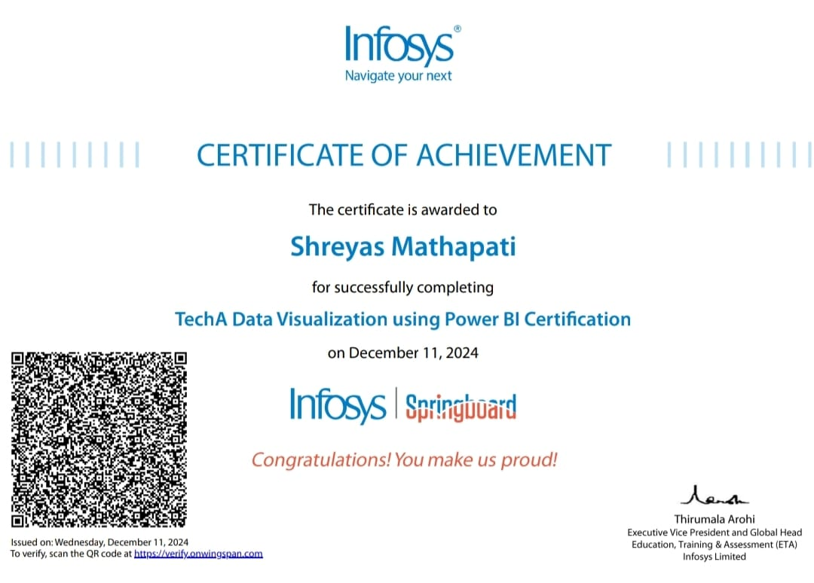

Status of Certifications
Infosys Springboard Certification: [Status: Completed].

Slide 19
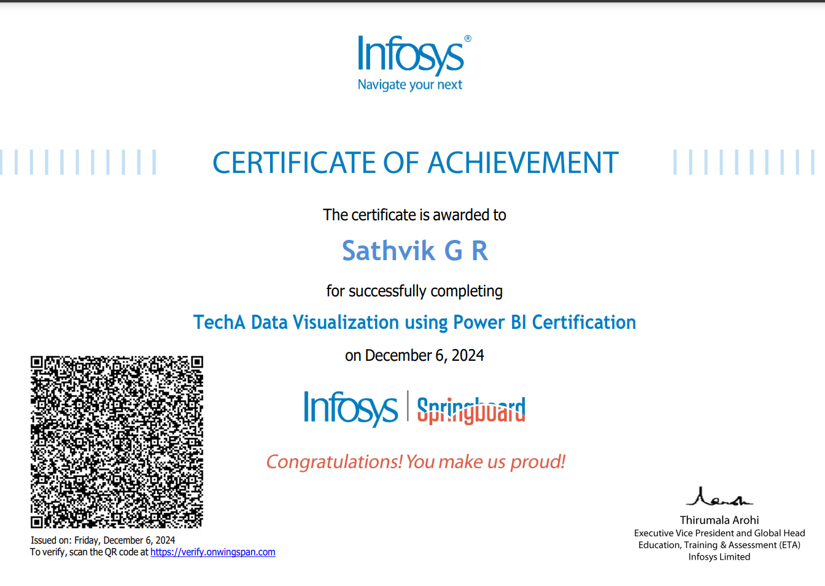

Status of Certifications

Slide 20

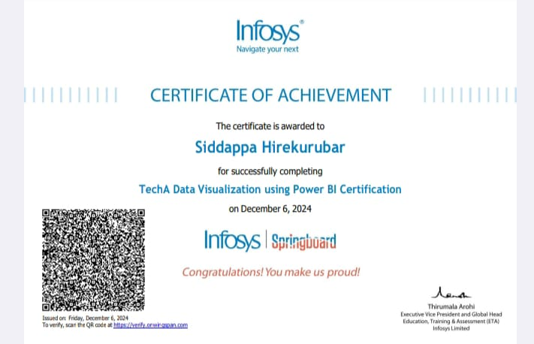
Status of Certifications

Slide 21
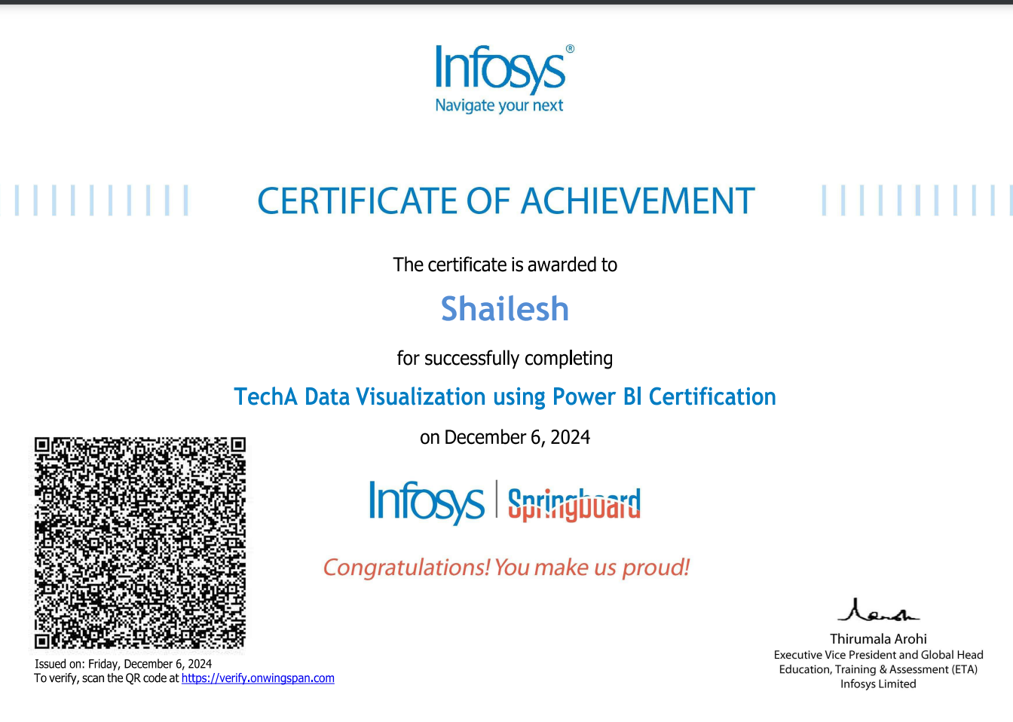


Slide 22
Conclusion
The dashboard provides valuable insights into the COVID-19 pandemic.
It highlights the potential for scaling or enhancing with additional data.
Call to action for policymakers, healthcare professionals, and researchers.

